Slide 1
MongoDB JSON Schema

Slide 2
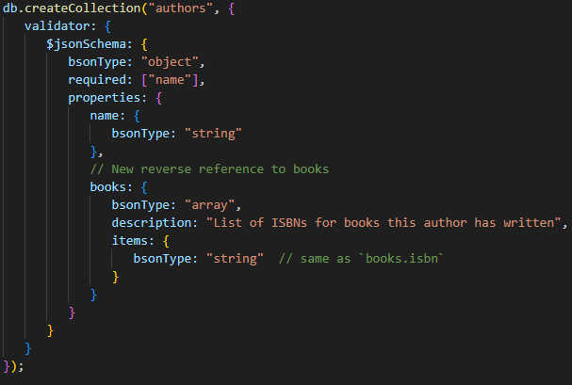
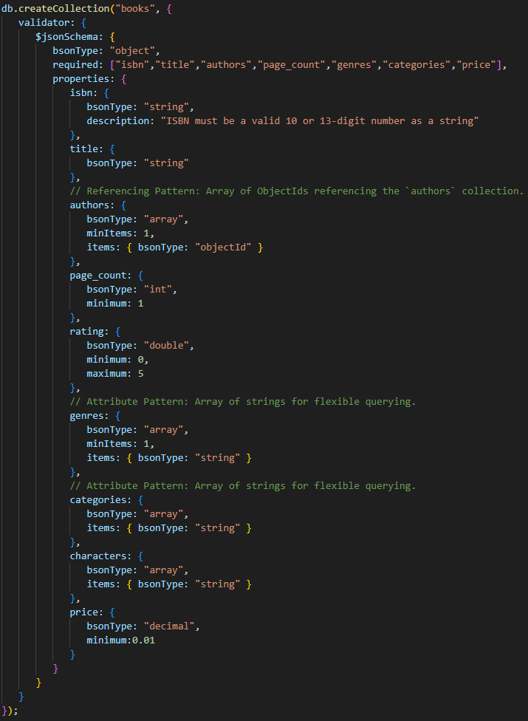
Schema Elements

Slide 3
Comparing SQL vs. Document vs. Graph Modelling
Conceptual to Logical
SQL
ER Model → Normalize → Tables + FKs + Join tables
Document
ER Model → Denormalize rules → JSON collections with embed vs. ref decisions
Graph
ER/Domain Model → Nodes & Relationships → Property Graph schema

